Slide 1
Recovery Pathways
Different types of Recovery

Slide 2
12 step groups and mutual Aid groups
Alcoholics Anonymous
Narcotics Anonymous
Cocaine Anonymous
Overeaters Anonymous

Slide 3
What are Mutual Aid Groups
The term mutual aid refers to the voluntary exchange of resources and services between community members to provide support for those who need it. These organized community efforts most often form within underserved communities and aim to empower people through solidarity rather than charity.

Slide 4
Faith Based Recovery
Celebrate Recovery
American Christian twelve-step program designed to facilitate recovery from a wide variety of troubling behavior patterns.
The purpose of Celebrate Recovery is to find God's healing power in our lives through the Eight Recovery Principles found in the Beatitudes and the Christ-centered Twelve Steps.

Slide 5
Medication Assisted Treatment
Medication-assisted treatment (MAT) is the use of medications, in combination with counseling and behavioral therapies, to provide a “whole-patient” approach to the treatment of substance use disorders.
Medications used
Buprenorphine
Methadone
naltrexone

Slide 6
MAT Medications
Buprenorphine- is an opioid partial agonist. It produces effects such as euphoria or respiratory depression at low to moderate doses. With buprenorphine, however, these effects are weaker than full opioid agonists such as methadone and heroin
Methadone-maintenance is a long-term treatment. The length of treatment varies from one or two years to 20 years or more. However, if the person taking methadone and their doctor agree to end treatment, the methadone dose is tapered down gradually over many weeks or months, easing the process of withdrawal.
Naltrexone-binds to the endorphin receptors in the body, and blocks the effects and feelings of alcohol. Naltrexone reduces alcohol cravings and the amount of alcohol consumed. Once a patient stops drinking, taking naltrexone helps patients maintain their sobriety.

Slide 7
Smart Recovery/ Self-Management and Recovery Training
SMART was created for people seeking a self-empowering way to overcome addictive problems. What has emerged is an accessible method of recovery, one grounded in science and proven by more than a quarter-century of experience teaching practical tools that encourage lasting change.
SMART Recovery is based on principles from Cognitive Behavioral Therapy (CBT), Rational Emotive Behavior Therapy (REBT), and Motivational Enhancement Therapy

Slide 9
What is Recovery
SAMHSA - Substance Abuse and Mental Health Services Administration. has developed a working definition and set of principles for recovery. Recovery is defined as:
“A process of change through which individuals improve their health and wellness, live a self-directed life, and strive to reach their full potential.

Slide 14
Stigma Reduction Recovery
a mark of shame or discredit : stain bore the stigma of cowardice. b plural usually stigmata : an identifying mark or characteristic specifically : a specific diagnostic sign of a disease.
Example of Stigma: When someone with a mental illness is called 'dangerous', 'crazy' or 'incompetent' rather than unwell, it is an example of a stigma. It's also stigma when a person with mental illness is mocked or called weak for seeking help. Stigma often involves inaccurate stereotypes.

Slide 15
Stigma Reduction = Recovery
Recovery Coaches, Peer leaders must demonstrate pride just as in any other industry.
Not everyone will want to do stigma reduction work.
Be very involved in organizations that advocate, be knowledgeable of all these resources
Write to editors, submit freelance articles.
Notes:
• Recovery Coaches, peer leaders must demonstrate pride just as in any other industry.
• Not everyone will want to do stigma reduction work.
• Be very involved in organizations that advocate ,be knowledgeable of all these resources
• Write to editors, submit freelance articles.
• Have students make lists, come to the front of the classroom and talk about it – verbalize what an editorial might sound like.
• Walk the walk, not talk the talk and live by recovery. • Have integrity: remain true to your pathway and your recovery. • Recognize appropriate boundaries and respect them, both for your coaches and for yourself
15

Slide 16
People Are Watching!
Inviting new people in recovery to these ideas adds value.
Beware of naysayers, they’re everywhere.
Be real and use common sense.
Integrate all positive things in your recovery as you did drugs.
No substitute for time except time.
Notes:
• Inviting newcomers to these ideas provides added value. • Beware of naysayers, for they are everywhere. • Be real and use common sense. • Integrate all positive things in your recovery as you did drugs. • There is no substitute for time except time.

Slide 21
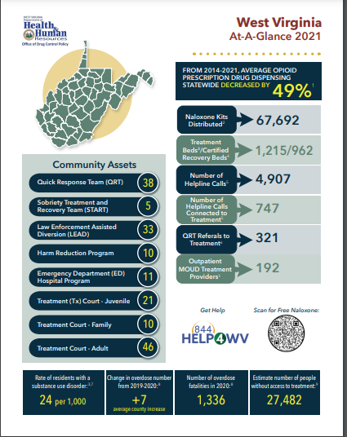
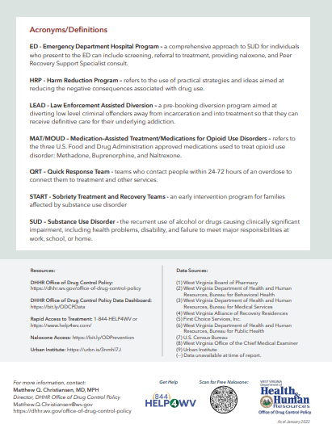
Notes:
In communities across the state of WV, we have 38 Quick response Teams, 5 (START) programs, 33 (LEAD) programs, 10 Harm Reduction programs, 11 Emergency Departments and hospitals staffed with multiple PRSS’. 21 Juvenile treatment courts, 10 Family courts, and 46 adult treatment courts.
From 2014 to 2021 average opioid prescription drug despensing decreased by 49%
Over 67,000 Naloxone kits were distributed across the state
1,215 Treatment beds and 962 Certified Recovery beds
Over 4,000 calls to the wv helpline (1 844 help4wv) and 747 of those calls were connected to treatment
Over 300 QRT referrals to treatment and 192 Outpatient MOUD treatment providers

Slide 22
RETURNING VETERANS
Notes:
Have a Veteran come to share with the class if possible.
Show Ted Talks and other PTSD and Veteran videos.
Discuss how providing recovery coaching to Vetrans is different?

Slide 23
Returning Veterans
Post-traumatic Stress Disorder (PTSD)
Substance Use Disorders (SUD)
How common is co-occurring
PTSD and SUD in Veterans ?
Notes:
• Posttraumatic Stress Disorder (PTSD)
• Substance Use Disorders (SUD)
• How common are PTSD and SUD as co-occurring orders among Veterans?
• Ask if anyone knows of any returning vets and if so what issues they think are important. Ask for discussions on what they know about returning vets.

Slide 24
Beware of Multiple Illnesses:
More than 2 of 10 Veterans with PTSD also have SUD.
War Veterans with PTSD and alcohol problems tend to be binge drinkers. Binges may be in response to bad memories of combat trauma.
Almost 1 out of every 3 Veterans seeking treatment for SUD also has PTSD.
Notes:
• More than 2 out of 10 Veterans with PTSD also have SUD.
• War veterans with PTSD and alcohol problems tend to be binge drinkers. Binges may be in response to bad memories of combat trauma.
• Nearly 1 out of 3 veterans seeking treatment for SUD also has PTSD.

Slide 25
How can co-occurring PTSD and SUD create problems?
If someone has both PTSD and SUD, it is likely that he or she also has other health problems (such as physical pain), relationship problems (with family and/or friends), or problems in functioning (like keeping a job or staying in school). Using drugs and/or alcohol can make PTSD symptoms worse.
Notes:
• If someone has both PTSD and SUD, it is likely that he or she also has other health problems (such as physical pain), relationship problems (with family and/or friends), or problems in functioning (like keeping a job or staying in school). Using drugs and/or alcohol can make PTSD symptoms worse.
• Other pains – social, mental, etc.

Slide 26
Talk to Vets
PTSD may create sleep problems (trouble falling asleep or waking up during the night). Vets might "medicate” themselves with alcohol or drugs because they think it helps their sleep, but drugs and alcohol change the quality of their sleep and make them feel less refreshed.
Notes:
• PTSD may create sleep problems (trouble falling asleep or waking up during the night). Vets might “medicate” themselves with alcohol or drugs because they think it helps their sleep, but drugs and alcohol change the quality of their sleep and make them feel less refreshed.
• Peer leadership is important. Veterans are accustomed to taking orders so use simple suggestions! They want to be heard. Do some role-playing if time allows.

Slide 27
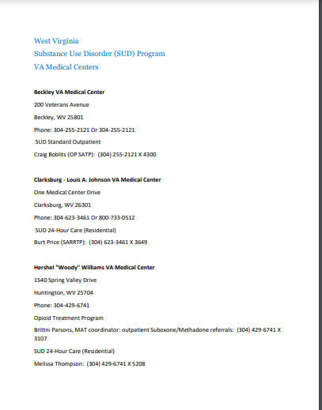
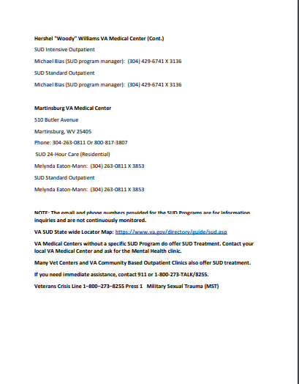
VA Medical Centers

Slide 28
Insist on getting Professional help:
PTSD makes them feel "numb," like being cut off from others, angry and irritable, or depressed. PTSD also makes them feel like they are always "on guard." All of these feelings can get worse when they use drugs and alcohol.
It is important that veterans get peer recovery supports for their SUD however PTSD help in part comes from professional venues.
Notes:
• PTSD makes them feel “numb,” like being cut off from others, angry and irritable, or depressed. PTSD also makes them feel like they are always “on guard.” All of these feelings can get worse when they use drugs and alcohol.
• It is important that veterans get peer recovery supports for their SUD; however, help for PTSD comes in part comes from professional venues.
• Peer social life is important but insist vets see counselors and social workers who are knowledgeable about veterans affairs.
28

Slide 29
Same Principles as SUD Recovery
Drug and alcohol use allows you to continue the cycle of "avoidance" found in PTSD. Avoiding bad memories and dreams or people and places can actually make PTSD last longer. You cannot make as much progress in treatment if you avoid your problems.
Talk and Listen, Talk and Listen, Talk and Listen !!!!!!!!!!
Notes:
• Drug and alcohol use allows you to continue the cycle of “avoidance” found in PTSD. Avoiding bad memories and dreams or people and places can actually make PTSD last longer. You cannot make as much progress in treatment if you avoid your problems.
• Talk and listen.
• Very important to “talk it out.” This can take hours and other recovering vets can play an important role as peers when they are available.
29

Slide 30
All Veterans feel different !
Veterans will drink or use drugs because it distracts them from their problems for a short time, but drugs and alcohol make it harder to concentrate, be productive, and enjoy all parts of their life.
Veterans really have a unique experience than most civilians that have never been in a war zone.
Notes:
• Veterans will drink or use drugs because it distracts them from their problems for a short time, but drugs and alcohol make it harder to concentrate, be productive, and enjoy all parts of their life.
• Veterans really have a unique experience compared to most civilians that have never been in a war zone.
• Veterans are trained to be different from civilians. It can take a lifetime for some vets to normalize.

Slide 31
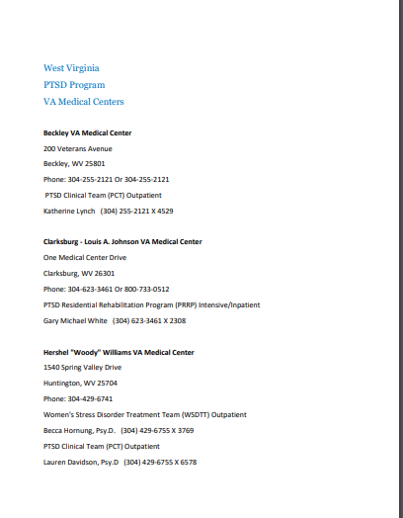
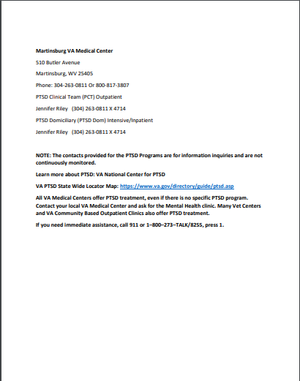
WV PTSD Programs

Slide 32
Co-Occurring Disorders
Psychotropic drug world and we are in it!
We are not doctors so don’t act like one
We do however have a keen ability to detect other disorders
We do know when a peer needs a higher pay grade assessment and possible services !
Notes:
• Psychotropic drug world and we are in it!
• We are not doctors so don’t act like one!
• We do however have a keen ability to detect other disorders!
• We do know when a peer needs a higher pay grade assessment and possible services!
• Just because we are not doctors and social workers doesn’t mean we can’t help those with disorders with our special qualifications with peer recovery supports from SUD’s

Slide 33
Recovery Ally and SUD
What It Means to Be a Recovery Ally: A recovery ally can be a family member, a lay person, a friend, an employer, a health care provider, a teacher, or anyone else who has a relationship with someone who is struggling with a substance use disorder. It has been said that the opposite of addiction is connection. The more connected a person with a substance use disorder feels, the better their chances are of entering and remaining in recovery. However, you need to have more than just a desire to help—you need an understanding of what the person is going through. You need to know what might trigger the person’s craving, what words will cause them to doubt themselves and their ability to recover, when their most challenging times are, and what situations they might need to avoid.

Slide 41
