Slide 1
Building a New Professional Identity
One Block at Time
Ruthann Arneson
Marshall University
Portfolio Presentation
Qualifying Assessment

Slide 2
If I have the belief that I can do it, I shall surely acquire the capacity to do it even if I may not have it at the beginning.
Mahatma Gandhi

Slide 3

Laying the Foundation
Acceptance into the program
Building a professional identity
Lively intellectual curiosities turn a world into an exciting laboratory and keep us ever a learner.
Lucy Sprague Mitchell

Slide 4
Constructing the Framework
Coursework:
CI 701 Curriculum Development
EDF 625 Qualitative Research
CI 677 Writing for Publication
  Fostering Friendships

Slide 5
CI 703 Theories, Models, and Research of Teaching
Personal Learning Theory
Curriculum Theory CI 702
Personal Curriculum Theory

Slide 6
Pinar
Bruner
Piaget
Bronfenbrenner

Slide 7
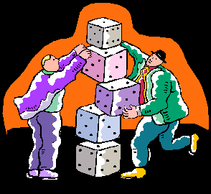
Raising the Walls Together
Collaboration
Carpooling
Seminars
June Harless Model School
Caring-about is empty if it does not culminate in caring relations.
Nel Noddings
Notes:
Carpooling with Cheryl Jeffers, Georgia Porter, and Lezlie Barton provided opportunity for friendships, to develop, reflect and problem solve. We worked on projects and formed a support system.
Seminars were a time to learn from peers about the process of putting together a residential portfolio, gain knowledge about topics pertinent to the doctoral program and celebrate the successes of peers
At the suggestion of Dr. Spatig in my first qualitative research class I began with interviews and observations at the June hairless Model School . This grew into a truly collaborative effort that continued for two semesters and culminated in co-writing an article.

Slide 8

Installing the Wiring
Scholarship
Association of Teacher Educators
An Approach to the Classroom That Models Compassionate Accountability
Inquiry Approach for Parent’s
Pre-k teacher in-service training
Co-teaching CI 634
  Early Childhood Programs
Notes:
In Models and Research in Teaching Cheryl Jeffers, Georgia Porter and Is and I completed a group project on Humanism. Dr. Meyer encouraged us to share this presentation with others to demonstrate how learning theories can be practically applied in the classroom. We presented at the Association for teacher Educators in Orlando FL. Feb. 2011
March of 2011 in Parkersburg participated with Dr. Dozier in Pre-k in-service training on the project method of teaching specifically incorporating how to actively involve parents
Co-taught with Dr. Dozier in spring of 2010 Teaching content I had expertise in , preparing lectures and PowerPoint presentations, along with engaging in class discussions was both satisfying and motivating.
My confidence grew as I actively participated in scholarly activities. The wiring was being added to the structure-the lights were coming on and the structure of a professional educator was emerging

Slide 9
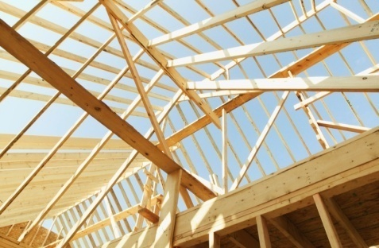
Putting on the Roof
Research
On-going evaluative research project at the June Harless Model School under the direction of Dr. Linda Spatig
Co-teaching EDF 625-Spring 2009
Research cohort led by Dr. Spatig
Annual Report
Notes:
Participating in research is like putting the roof on to the structure I have been building throughout my participation in the doctoral program. My initial thought when I started in the doctoral program was “What do I know about Research?” As I moved through my first qualitative research class I became involved in an ongoing evaluative research project at the June Harless Model School under the direction of Dr. Spatig. Weekly meeting with the group allowed me to build my skills on collecting and analyze data. Other members of the group conducted focus group interviews so I was exposed to additional kinds of data collecting. The outcome at the end of the semester was an Annual Report co-authored by the research team which provided constructive and formative feedback to Marshall University project administrators and school administrators. As a result of our feedback, changes were made in some school policies.

Slide 10
Co-author “mind AND heart”: Caring Learning Communities Bridge the Testing Divide”
  Dr. Linda Spatig, Fr. Paula Flaherty, Ashley Stephens, Cheryl Jeffers, Ruthann Arneson
Appalachian Studies Association Conference
  “Creating a Caring Learning Community in an Appalachian School”

Slide 11

EDF 711 Survey Research
  Group Survey
  Group Survey Report
  Individual Survey

Slide 12
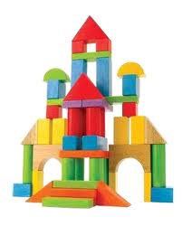
Finishing the Construction
Professional Identity
Increased depth of knowledge
Scholarship
Collaboration with Faculty and peers
Enhanced ability to conduct research
Often when you think you’re at the end of something, you’re at the beginning of something else
Fred Rogers

Slide 13
A New Professional Identity
Looking Ahead….
  Ready to begin the dissertation process
  With new skills and confidence I am ready to meet the challenge
  Plan on conducting a qualitative study examining the issue of transitioning pre-k children into kindergarten. Examining attitudes of teachers and identifying what practices best support children and families through this process.

Slide 14
Special Thanks
Committee Members
Dr. Linda Spatig, Ed. D., Committee Chair
Dr. Ron Childress, Ed. D.
Dr. Janet Dozier, Ed. D.
Dr. Louis Watts, Ed. D.
Family and Friends

