Slide 1
Creating a Painting: A Reflection of My Journey to EdD Candidacy
Jessica Hanna
Portfolio Presentation
Marshall University
Notes:
Welcome everyone.
Explain that I began painting when I started the doctoral program as a way to relieve stress.
As I’ve grown as a painter; I’ve also grown as a doctoral student.

Slide 2
Personal painting method
Prepare the foundation
Block the background
Underpaint and block the middle
Add definition
Paint the foreground
Highlight and glaze the painting
Incorporate the details
Finalize and add accents
Notes:
I am a self-taught painter. I’ve read several books over the past 2.5 years and have developed my own personal painting method.
As I reflected on my time in the doctoral program, I realized that my painting method mirrored my doctoral journey.

Slide 3
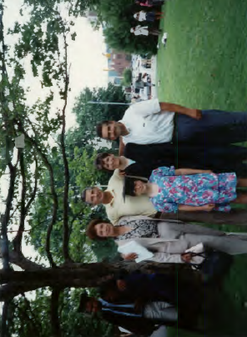

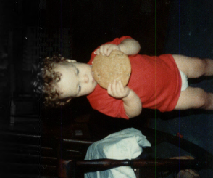
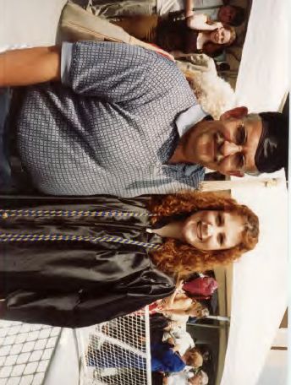
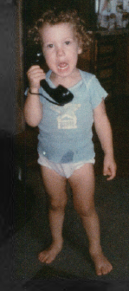
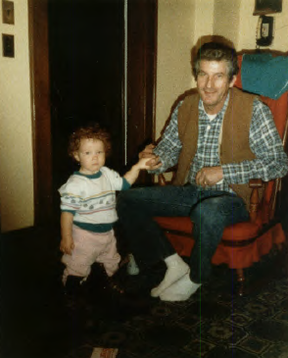
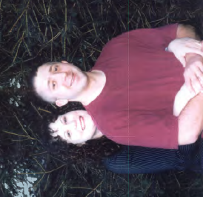
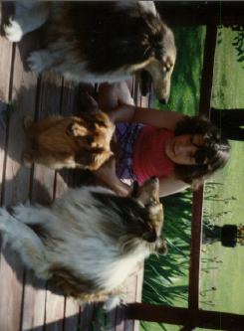
Step one: prepare the foundation
Notes:
My foundation for the doctoral program began long before I decided to apply. We have to go all the way back to my first memories of my mom telling me “You WILL get a college education.”
Pictures:
2) Maybe it was because they knew I was a natural born lecturer (pause).
3) Or perhaps they new I’d grow up and need to fill large shoes (pause).
4) Or they already knew I liked to be the center of attention. Regardless, I grew up knowing college wasn’t an option, but an expectation.
5) All the lectures were for naught, though, because when I was nine-years-old, I made the decision to go to college. In fact, it was at my mom’s college graduation that I found out you didn’t have to be a medical doctor to be called doctor. On this June day in 1990, I decided I wanted to become a doctor. I didn’t know what kind of doctor, but I wanted the title.
6) Thirteen years later, I walked across that exact same stage to receive my bachelors. Three years later, I walked across the same stage again, and received my masters.
7) Through life’s twists and turns, I began working as part-time faculty at Central Ohio Technical College and discovered how much I enjoyed teaching college. Twenty-two years after I had decided I wanted to become a doctor, I finally knew what type. I wanted to become a doctor of education. My foundation laid, the doctoral journey was about to begin.

Slide 4
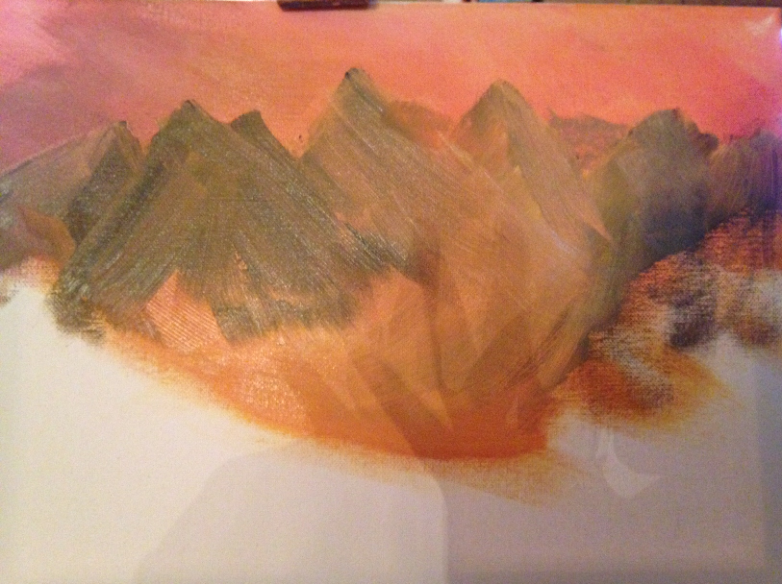
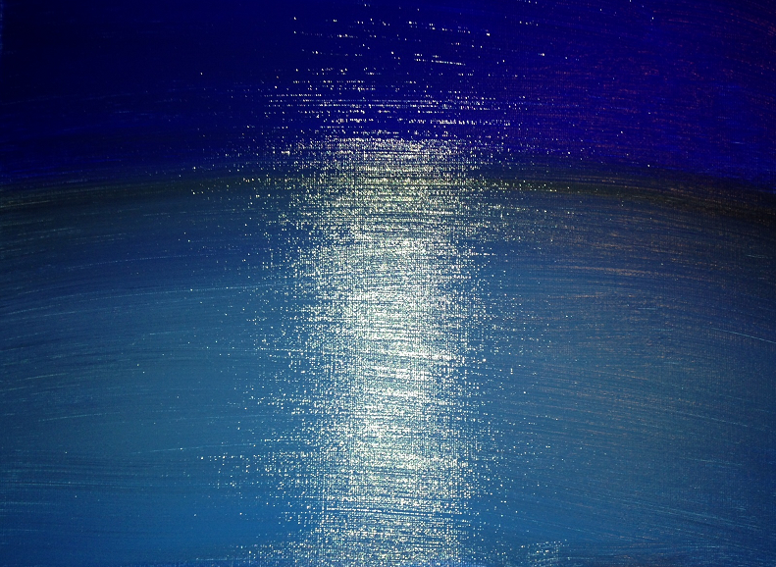
Step Two: Block the Background
Painting
  Add undertones and outline larger features
  Very abstract & frustrating
EdD Candidacy Journey
  LS 703 Research Design
  Learning to let go of control
  Building the background
Notes:
LS 703 – Provided an overall framework for the level of expectations throughout the program
It shook me to the core. I had done previous action research in my MBA program, but nothing like this.
Words like primary resources, IRB Review, Mixed Methods were tossed around.
I think I had the deer in the headlights look for the majority of the semester!
Learning to leg go –
But this isn’t to say I didn’t learn. Quite the opposite, I learned a lot about research. But, I also learned that I was a complete and utter control freak
Dr. Yeager’s Politics course was very laid-back, and I couldn’t stand it.
Today I yearn for such a relaxed, open-ended course, but back then I hated it.
Building the background
But from this semester I learned a lot about letting go of control to let the research guide me. I didn’t need to have all the answers, I just needed to follow the clues.
I learned that this new world of education was, at times, confounding.
I learned that I was not supposed to understand everything yet….I had only just blocked my background.

Slide 5
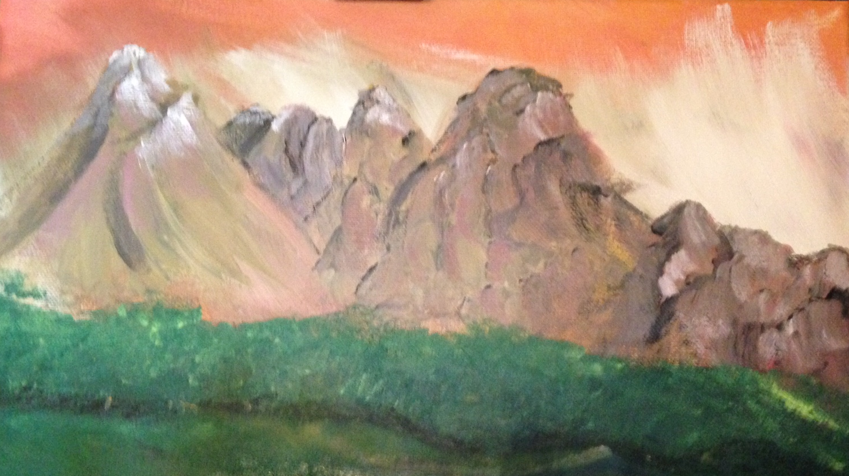
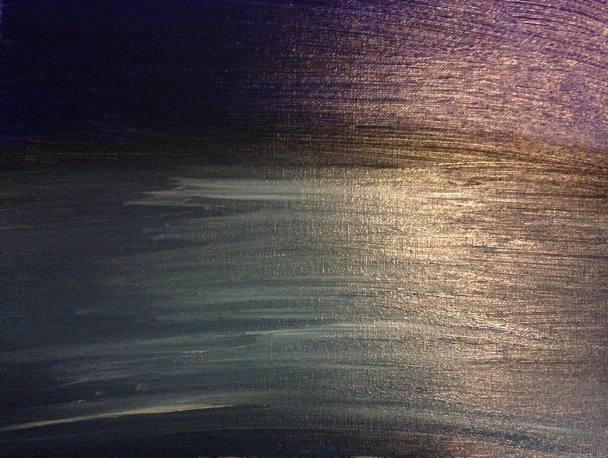
Step Three: Underpaint & block the middle
Painting
  Image begins to take shape
  Trust the process
EdD Candidacy Journey
  Embrace the confusion
  Trust the process
  Find my footing
  EDF 517, LS 705, LS 747, LS 745 & EDF 711
Notes:
Embrace the confusion
At the beginning of Spring 2013 semester, through Summer semester, I felt woefully inadequate as a student.
But I also realized that many students have completed the program before me; therefore, the process had to work!
I decided to embrace the confusion and trust the process.
Finding my footing
Looking back, the courses I took were a gift.
EDF 517, Statistics, was a math class…an area I felt rock-solid in.
LS 705, Administrative Theory, introduced educational leadership ideas that were very similar to business leadership. I found my footing in this course, and was able to bridge past information with new knowledge.
LS 747, CC Administration, and LS 745, HE Law, allowed me to see beyond my current point in the program. I was able to visualize the future and got a taste of what I would be doing upon graduating.
EDF 711, Survey, was the first research course that really bridged the gap between theory and practice. I realized I could really do something useful with my research knowledge.
It all started to make sense. I finally felt like I was standing on solid ground.

Slide 6
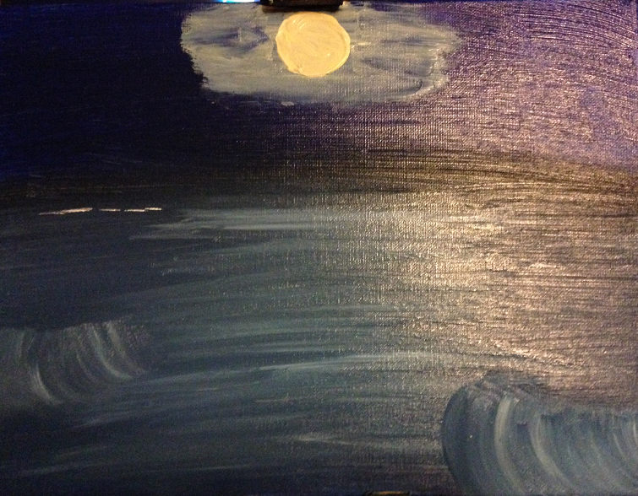
Step four: add definition
Painting
  The epiphany
EdD Candidacy Journey
  LS 707 – Ethical Theories
  Light and Knowledge
  Responsibility to Society
Notes:
Explain the epiphany process of painting!!!!
My doctoral epiphany occurred in Fall of 2013. In the middle of an academically tough semester!
LS 707. This class was the most mentally challenging one of the program. I credit this course for preparing my mind to accept the epiphany that would occur. This class rocked my foundation to its core. I learned some things about myself, including the foundation of my morals, that still shock me today. Dr. Nicholson challenged us to become better. She tore down our walls and built us back up better and stronger. Whenever I make an argument I ask myself, “Could I defend this to Dr. Nicholson?”
Somewhere between Nietzsche and Aristotle I realized that I just didn’t have research skills, I had become a researcher. But this wasn’t the epiphany.
My epiphany occurred when I realized that becoming a doctor of education was not about obtaining the title of doctor. Since I was little, I had wanted the title, but didn’t understand what it meant. I suddenly realized that becoming a doctor of education was not something to be jovial about. It was a serious lifetime commitment. It was about becoming a contributing member of an elite community of scholars that constructed arguments based on research and hard facts in an effort to better the field of education.
It was at this point that I embraced the change and altered my journey. I stopped looking at myself as merely a student and started viewing myself as a future practitioner.

Slide 7
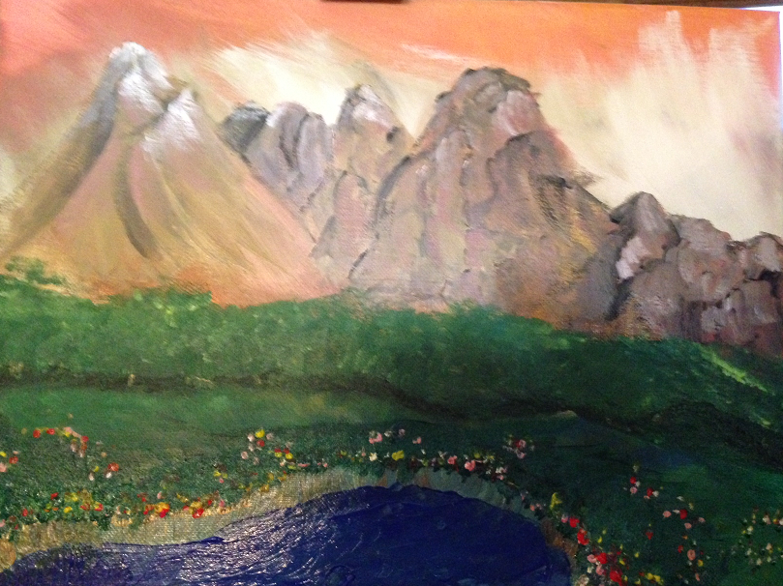
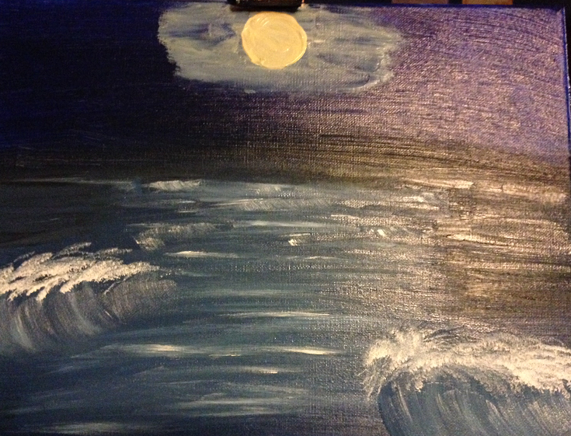
Step five: paint the foreground
Painting
  Most fulfilling step
  Painting finally looks like a painting
EdD Candidacy Journey
  Professional/Academic
    2013 Doctoral Student/Faculty Seminar
    Co-teaching EDF 517
  Scholarship
    SRCEA Experience
  Other Minor Projects
Notes:
With my new found knowledge that I was working towards becoming a practitioner in the forefront of my mind, I began to work on my key portfolio pieces.
The Doc Seminar gave me a leadership experience that I had not had before. I had planned events previously, but not on this scale. Dr. Kolsun and Edna Thomas retired the summer before, right in the middle of planning.
Co-teaching EDF 517 was different from what I expected. I’ve taught many courses over the past four years, both undergraduate and graduate; including online and face-to-face. However, Dr. Meisel provided me with opportunities to take my experiences and knowledge and grow. I learned how to create effective and useful rubrics. I learned more about providing feedback in an upbeat and positive manner, even when telling a student she totally missed the point. I learned to relax and let the course content guide my teaching methods.
SRCEA – First real-world conference.
Got pulled into the WV School Board Association self-assessment project
We designed the survey, administered it electronically with Survey Monkey, analyzed the results with SPSS

Slide 8
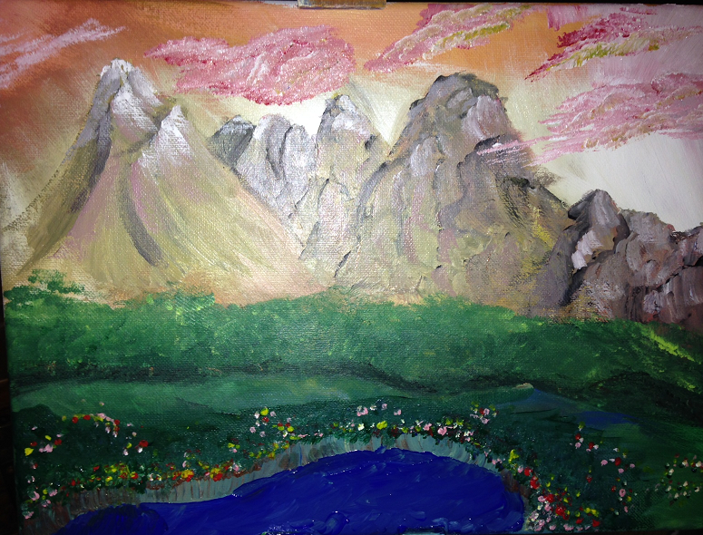
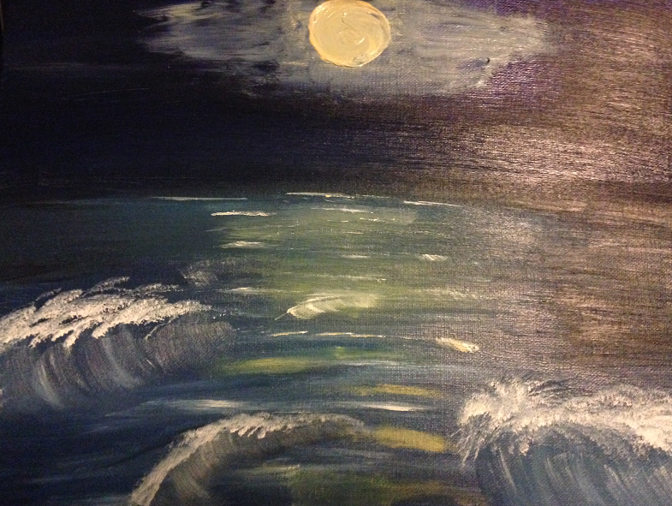
Step six: highlight and glaze the painting
Painting
  Perfect the painting
  Longest step
EdD Candidacy Journey
  LS 710 – Principles of Leadership
  Personal Leadership Model
    Transformational, Transactional, LMX
    Personal Leadership Crisis Model
Notes:
Talk about finishing up LS 710 in the Fall 2013.
I developed my own personal leadership model. From all of the previous courses and portfolio experiences, I was able to truly understand the different theories.
Situational leadership is implied.
Something no class talked about was a personal leadership crisis model.

Slide 9
Step six: highlight and glaze the painting
EdD Candidacy Journey
  Teaching ATE 550, 628, LS 690
  Seeking out more experiences
    2014 SRCEA
    2014 Doctoral Student/Faculty Seminar
    Redesign LS 532
Notes:
I’m still at this stage, but my journey is not complete.
I’ve used my knowledge gain in the program when teaching ATE 550, 628 and LS 690. I actively seek out more experiences that are not required for the doctoral program. I just got accepted to present on a topic at SRCEA that may be developed into a possible dissertation topic. I’m still actively involved with advising the 2014 doctoral seminar chair. I’m redesigning real-life courses.
However, despite all of these experiences, I’m not done with my journey. My paint is dry, but my painting requires the finishing touches.
The next step is to take on an original research project and complete the dissertation.

Slide 10
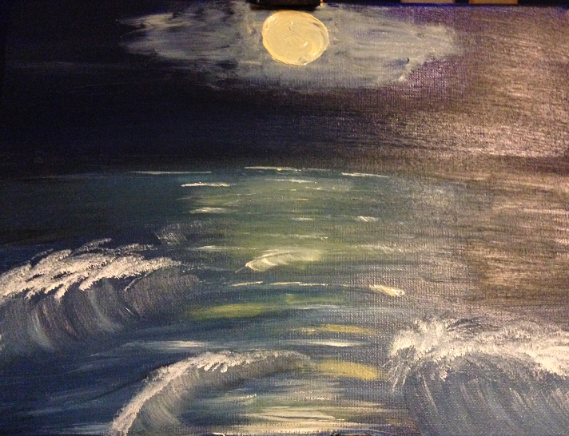
Step Seven: Incorporate the details
Step eight: finalize and add accents
Painting
  Patience
  Let it dry
EdD Candidacy Journey
  Prospectus (Step Seven)
  Defend the Dissertation (Step Eight)
  Enjoy the Journey
Notes:
Therefore, I’m ready to take the big step into incorporating the details and adding the accents. I know what it means to be a researcher and practitioner. I know my paint is dry and I’m excited to start the step. But I’m also resolved to be patient and enjoy the journey.
The fun part of painting is creating the masterpiece, it’s not staring at the finished work of art. The same goes for my doctoral journey. I don’t want to rush through the dissertation process, but soak up everything I can from it. Only then, will my masterpiece complete.

Slide 11
Thank you to my committee
Michael Cunningham, Ed.D., Committee Chair
Louis Watts, Ed.D.
Lisa Heaton, Ph.D.
Eugenia Damron, Ed.D.
Pamela Anderson, Ed.D.

