Slide 1
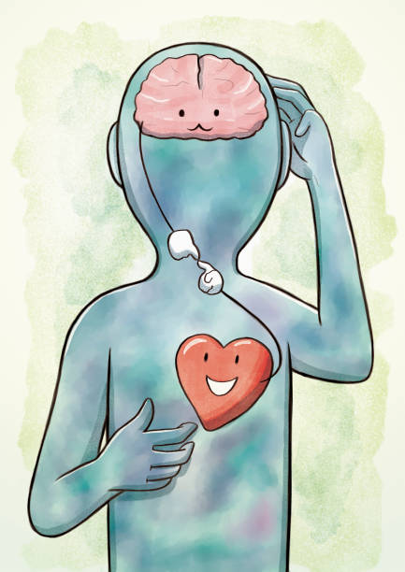
How to Have a
Healthy Head & Heart
For a Fresh Restart
Amy Staples M.A.
Director
WV Behavior & Mental Health
Technical Assistance Center

Slide 2



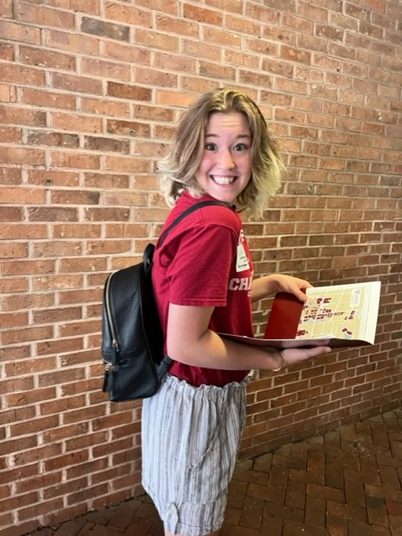

Slide 3




Slide 4




Slide 5

Today's Objectives
What is self-care
Why it's important
A few strategies

Slide 6
What is self-care?
Any action that you use to improve your health and well-being.
Self-care is anything that you do for yourself that feels nourishing.
It could be anything that floats your boat — anything that puts a smile on your face.
Any action that makes you feel cared for, even if it's you caring for yourself.
https://www.everydayhealth.com/self-care/
Notes:
Self-care is the act of pausing and listening to you. What do you need to take care of yourself. No one can tell you how you should engage in self-care.

Slide 7
What is Self-care
Why are we here?

Slide 8
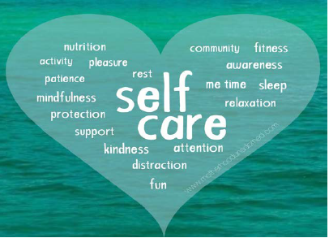
Self-care Involves
Tending to your
  Body
  Intellect
  Mind
  Practical Needs
  Social Needs
  Spirit

Slide 9

Also Known As
Self-care
Self-help
Teacher Wellness
Staff Wellness
Personal Optimization
Notes:
Self help implies there is a problem. Self care is meeting yourself where you are and taking care of your self

Slide 10

What We Know
It is essential if you want to avoid
  Chronic stress
  Burnout
  Limited productivity
Your best self!
You deserve to be cared for too!

Slide 11

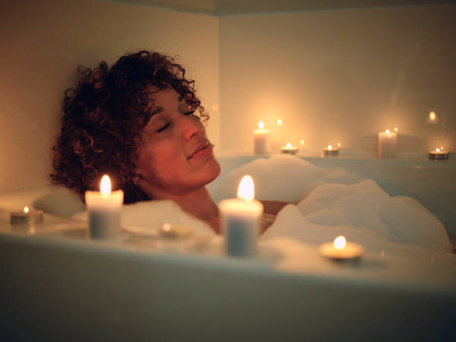

Slide 12
Think about it!
A study published in April 2018 took self care to mean “the self-initiated behavior that people choose to incorporate to promote good health and general well-being”. The study authors added that it’s about being healthy but also about incorporating coping strategies to deal with work stressors.
Notes:
Daily chores like making your bed in the morning are also examples of self-care — or can be. “This is where that individuality comes into play, because for some people there is no way making a bed feels like self-care — it may just feel like a chore,” Amsellem says. But if it helps you claim your day and gives you a sense of accomplishment early on, you’ll have that with you even if the rest of the day gets derailed, Amsellem says.

Slide 13

Self-care is a Way of Life
It's a daily, hour by hour, minute by minute practice
It means listening to yourself
Showing up for yourself
Putting yourself first
Having a purpose

Slide 14
Do not make the mistake!
Self-care is not Self-indulgence
Self-care
Self-indulgence
Promotes long-term health outcomes
  Fostering resilience
  Living longer
  Better quipped to manage stress
  Higher self-esteem
Can be small-to large-scall habits from eating healthy to meditation
Don’t have lasting benefits
Habits like marathon watching TV and junk food substitute solutions to problems
Notes:
Self indulgence would be getting manicures weekly if your budget doesn’t allow. Eating ice cream for breakfast lunch and dinner or binge-watching Yellowstone instead of finishing a project that is due Monday.

Slide 15
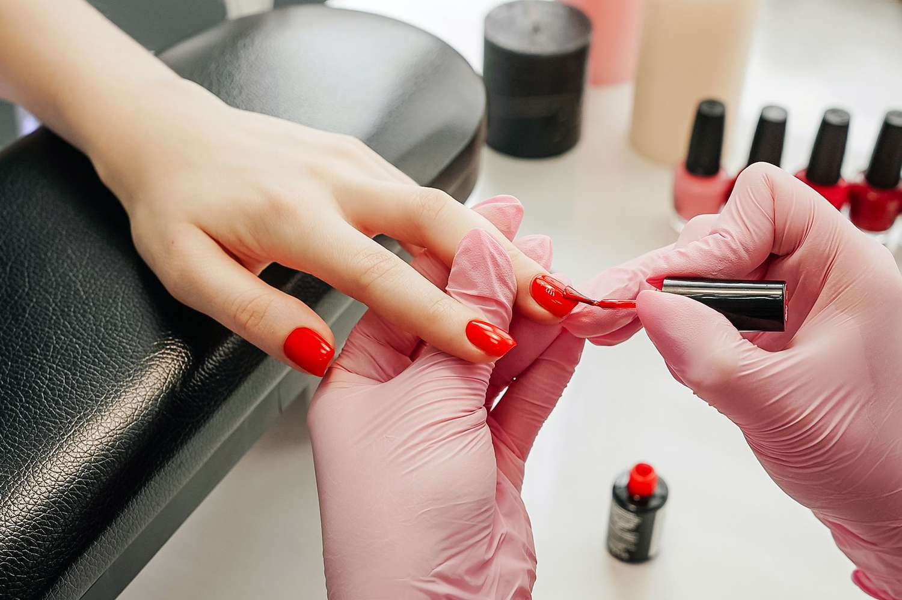
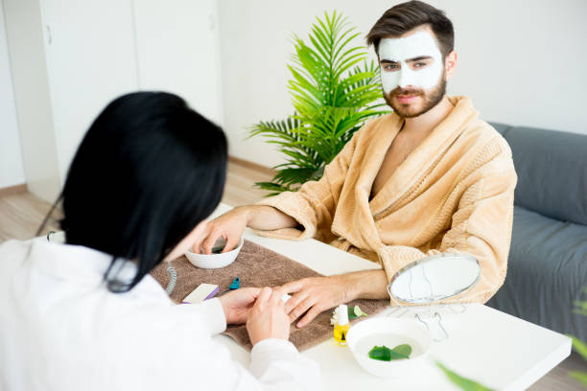


Self-Care

Slide 16


Self-care For Men
Ask for help when needed
Put yourself first
Find your passion
  Boost your brainpower
Skin care/Pampering
  Beard oil
  Moisturizer
  Lotion
  Hot-shave
Have regular check-ups

Slide 17

Professional Learning is Self-Care

Slide 18
Also, Self-care
Saying no when appropriate
  Can’t join every team
Setting healthy boundaries
  Social media
Building your self-esteem
  Professional learning
Teaming
  Working with colleagues to problem solve
Actively engaging in your life
  What do you enjoy

Slide 19
Why It’s Important
I don’t have time for this!

Slide 20
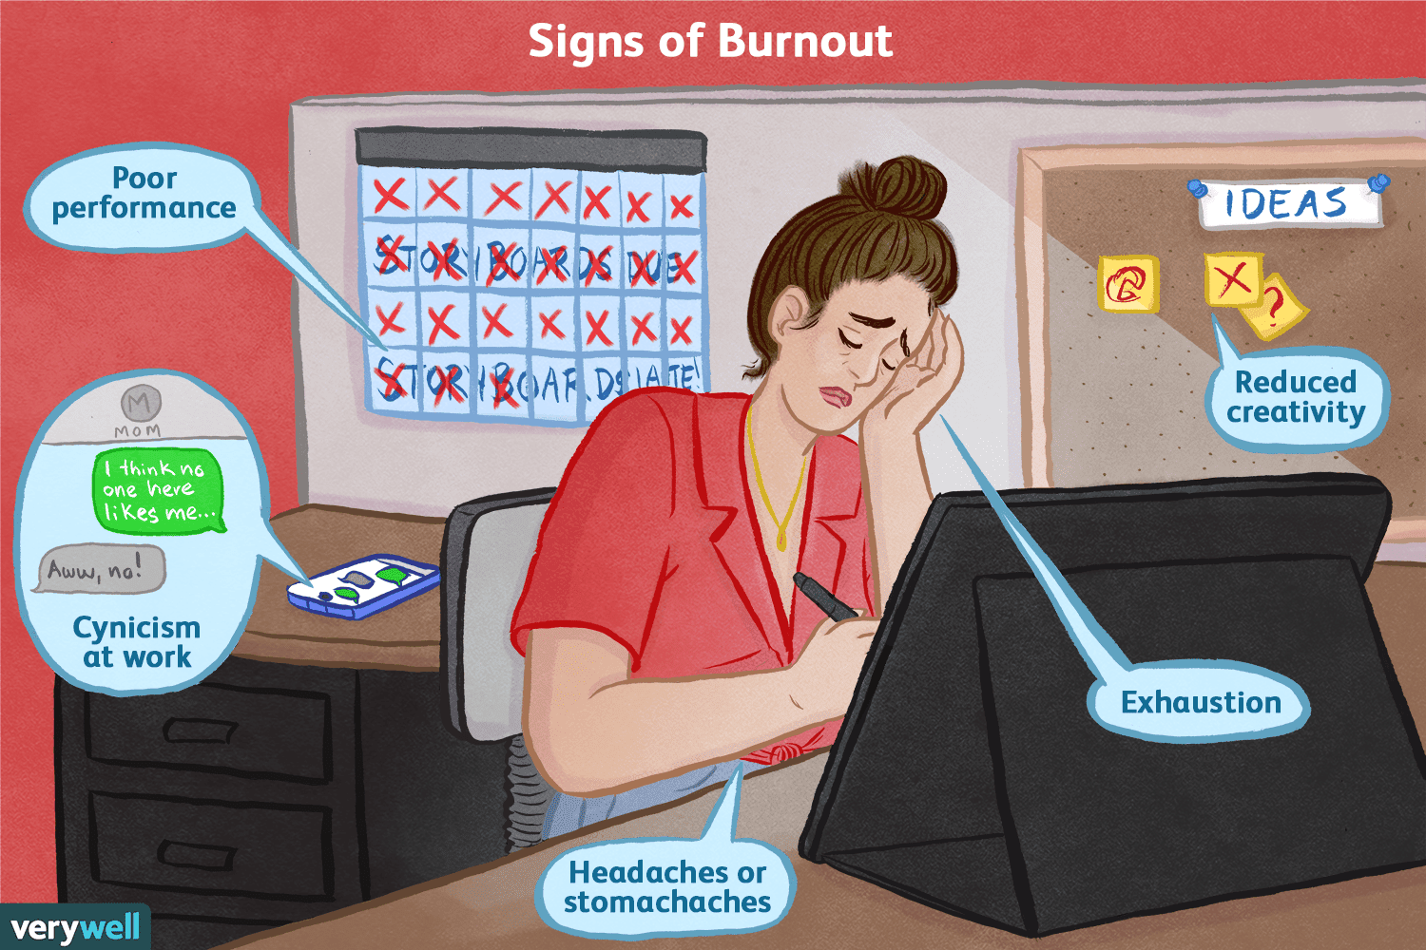
Why is it important?
Self-care can help educators prevent burnout, interact more effectively with students, and can even create school climates more conducive to learning.

Slide 21
It's No Walk in The Park
Starts early
Working nonstop
Time on your feet
Constant teaching
Endless cleaning

Slide 22
Let's Not Forget
Underpaid
Underappreciated
Misunderstood
Undertrained

Slide 23
Childcare Stress & Burnout
Over 40% of teachers report feeling high stress every day during the school year.
Cause of stress
  Lack of resources
  Class behavioral problems
Burnout: A state of mental and/or physical exhaustion (low energy and unable to support others) resulting from extended periods of stress overload (Girdin, Everly, and Dusek, 1996).
Outcomes: weakened physical and emotional health!
Notes:
Ties teachers with nurses as having the highest stress rate of any career. Waterfod 2021
When left unchecked teacher stress can lead to burnout and contribute to high turnover.

Slide 24

Professional Quality of Life
Compassion Satisfaction
Compassion Fatigue
The positive aspects of helping
The good stuff
The negative aspects of helping
The bad stuff

Slide 25

Compassion Satisfaction
The positive aspects of helping
  Pleasure & satisfaction derived from working in helping, care giving systems
May be related to:
  Providing care
  Working with colleagues
  Beliefs about self

Slide 26
You love kids
Fun is encouraged
Can share your love of learning
Job security
Intangible rewards
It’s more than a job
Can make a difference

Slide 27
What’s Your Why
Activity
Why did you become a _________?
Why did you choose ___________?

Slide 28
Compassion Fatigue
The negative aspects of helping
  Providing care
  Working with colleagues
  Beliefs about self
Burnout
Work-related trauma

Slide 29
Secondary Traumatic Stress (STS)
Work Related Traumatic Stress
  Primary traumatic stress direct target of event
  Secondary traumatic exposure to event due to a relationship with the primary person
STS
  Work-related secondary exposure to extremely or traumatically stressful events
Both share negative affect
  Burnout is about being worn out
  STS is being afraid

Slide 30

Making “Changes” to Improve Self-Wellness

Slide 31
Admiring Problems vs Mindset
Admiring The Problem
Mindset Shift
I can’t believe Ms. Kathy is doing that.
I don’t understand why we must do another assessment.
I had his sister and that whole family has issues.
You know her mom is in jail.
If I have to deal with that grandfather one more time I am going to scream.
Hmmm I wonder why Ms. Kathy is doing it that way.
Can you tell me what the outcomes of this assessment will be.
I know the family has struggled in the past. Maybe I can share somethings that worked for me.
So, we know she has at least an ACE score of 1.
There is a family history of trauma.

Slide 32
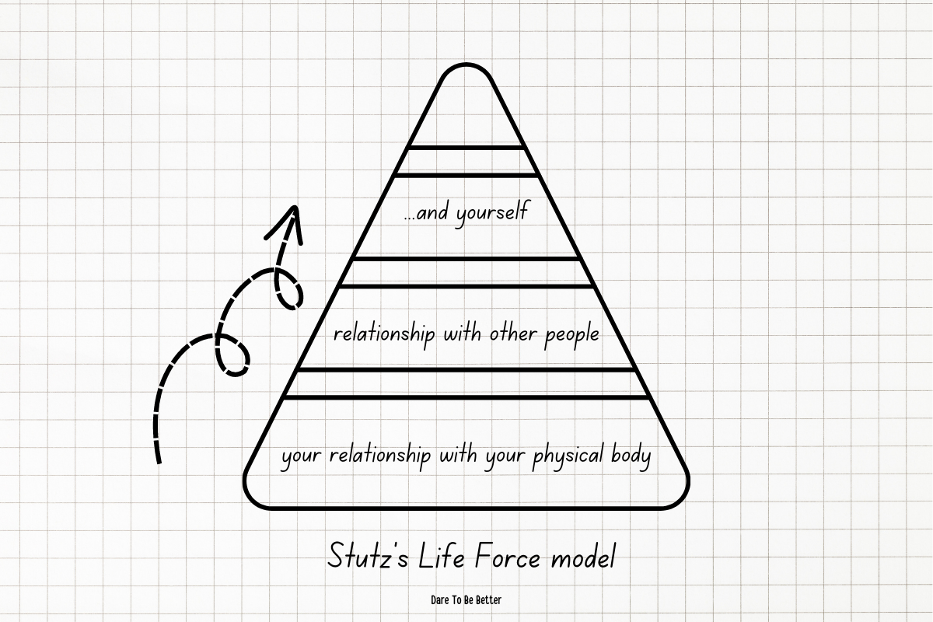

Slide 33
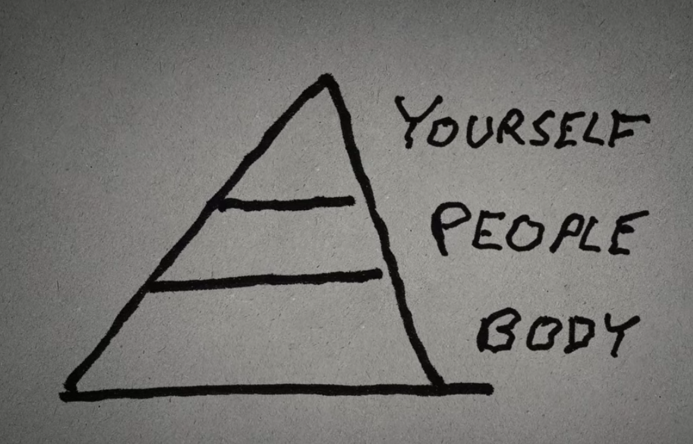

Slide 34
Managing Stress

Slide 35
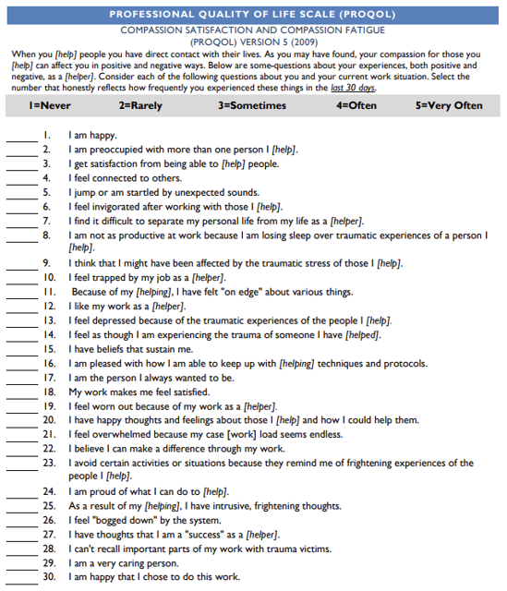
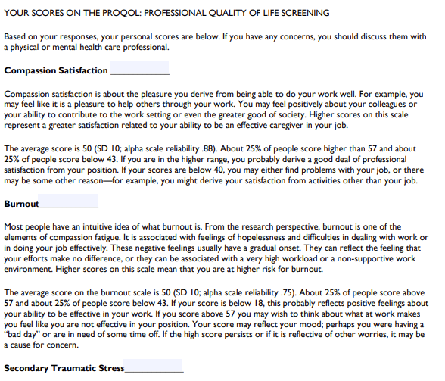


Slide 36
Healthy Ways to Respond
Healthy Alternative Activities
  Doing something else that’s healthy for you to distract yourself
Reframing
  Finding the lesson to be learned in this situation
Problem Solving
  Breaking down the issue
Social Support
  Seeking ideas of clarity form other

Slide 37
Unhealthy Ways to Respond
Avoiding or denying the stressor
Numbing and blunting your reaction
Using your social support systems to justify your actions

Slide 38


Hot Buttons
Disrespect
Physical aggression
Spitters/bitters
Whining
Tattlers
Colleagues
https://www.tiktok.com/@lydberube/video/6914385438513974534

Slide 39
Control the Controllables
Step 1:Organize
What can you control?
What can’t you control?
How much energy are putting on the cants?

Slide 40
Control the Controllables
Step 2: Prioritize
Can | Can’t
Build Relationships | Their Opinion
Promote Structure and Routines | Weather/School Closing
Teach Skills (social-emotional) | Curriculum
Set Boundaries (work and home) | If Others Don’t

Slide 41
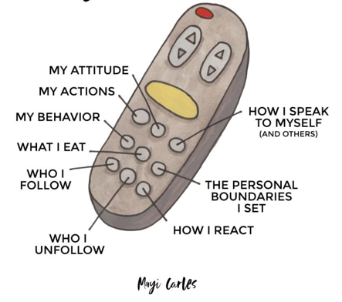
From all the things on your mind, direct your energy on the things that you can control.

Slide 42
A Few Strategies
Have a toolbox for yourself.

Slide 43
Activities for You & Your Class
Group mindful breathing exercise
Mindful moments
Gratitude journals
Round Robin shout-outs
Movement breaks
Muscle relation break

Slide 44
Everyday Classroom Strategies
Model Self-control & Self-Regulation
Provide Structure & Predictability
Anticipate Transaction
Label your own feelings
Model your skills
  Make your internal dialogue external by:
    Talking through problems out loud
    Model decision making steps

Slide 45
Self-Care During the Workday
Plan for 10-20 minutes a day where you can decompress
Ask for help
Help someone else
Bring a self-care "emergency pack" to school
Have reasonable expectations for yourself

Slide 46

Check-In / Check-Out
Builds a Climate of “Trust” and “Support”
Poking your head in the door and ask the question, “Do you need anything?”
  Students with Challenging Behaviors
  Newer Teachers
Provides an opportunity to show support, in addition to recognizing a teacher.
  “You Got This…”

Slide 47

Staff Wellness is “Directly Affected” by the “Climate” of the School
There is no doubt that in schools where there are high levels of harmony and a positive outlook, staff usually experience:​
​
Greater job satisfaction​
Improved sense of belonging​
A sense of safety​
Less absenteeism​
Sense of connection ​
Higher levels of job performance​
​
Marie Amaro, How School Culture Impacts Teacher Wellbeing​

Slide 48
Members of the school community want to have a “voice” and feel “valued”
Members of the school community want to have a voice & feel valued!
Teachers’ Perceptions of Organizational School Climate and Communication Satisfaction Study:
  School communication influences a teacher’s attitude and their behavior, thus directly impacting school effectiveness (Rafferty, 2003).
Janet Jahn, 2019

Slide 49
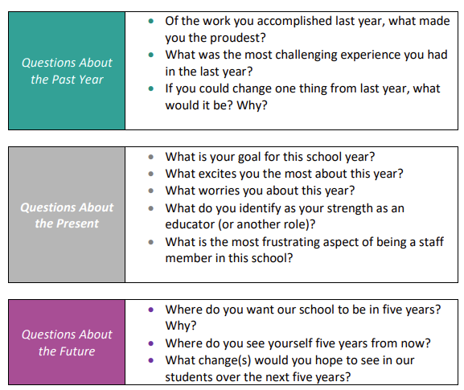

Listening Tour:
The Past, Present and Future
As you conduct your Listening Tour, consider these questions to generate feedback.
Evaluate the feedback and “act” at least on one comment.
Notes:
Let them see their recommendations or suggestions to improve school climate

Slide 50
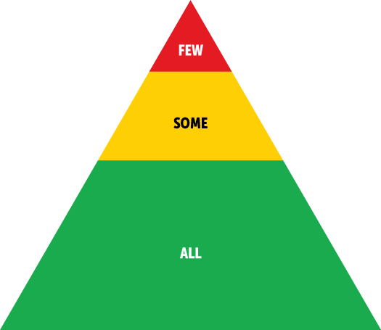
TIER 3 (Few)
Person Centered Planning
  Pro-QoL (Compassion Fatigue)
EAP (Anonymous)
PEIA Representative
  Message Therapy
Mental Health Resources (general)
Mentoring
Self-Select: “Supports” Not Mandates
TIER 2 (Some)
Buddy System
  Tap-In/Tap-Out
  Check-In/Check-Out
  Mentoring (New Teachers)
Calming Space
Practice-Based Coaching
Gratitude Practices
  Acts of Service
  Gifts/Notes
Classroom Management / Organizational Skills
Book Studies
Before / After School Activities
  Yoga
  Mindfulness Activities
Group Sessions:
(school social worker / out of school mental health)
TIER 1 (All)
Weekly Morning Meetings (Staff Connection / Temp. Checks)
Adult Mental Health First Aid Training (6 hours)
Wellness Support Team
  Listening Tours
  Data Collection (TIPS)
  Job Satisfaction Survey
Relationship Building and Supports (teams per each grade level/subject)
Staff Wellness Mission and Expectations
Predictable and Consistent Routines and Procedures that Promote Staff Wellness
  School-wide / Classroom Safety Plans
  Mind/Movement Breaks in Daily Schedules
Adult Social Emotional Learning
Professional Development
  Self-Wellness Awareness and Self-Advocacy
  Trauma Informed Classrooms
  Classroom Management / De Escalation Strategies
Gratitude Practices
  Private/Public Acknowledgements
Notes:
Supports NOT Mandates
Self Select Yourself

Slide 51
Control the Controllables
Nothing New Here:
Its doing what you already know but doing it well.
We Can’t Fix Everything:
Pick one (or two) strategy. Focus on it and implement it consistency and fidelity.

Slide 52
Today's Objectives
What is self-care
Why it's important
A few strategies

Slide 53
References
https://www.waterford.org/education/teacher-self-care-activities/
https://positivepsychology.com/self-care-activities-groups/#self-care
https://mcleanonline.medium.com/dont-admire-the-problem-13dfad8c5d87
https://www.everydayhealth.com/self-care/
https://mhttcnetwork.org/
https://blog.bonsecours.com/healthy/men-self-care-tips/#:~:text=Take%20time%20to%20meditate,reduce%20stress%20and%20improve%20sleep.
Jones, Teryl. Staff Wellness: MTSS Approach​ Framing adversities and educators’ distress as a collective ​rather than an individual problem. 2023. WV BMHTA Center.

Slide 54


Slide 55
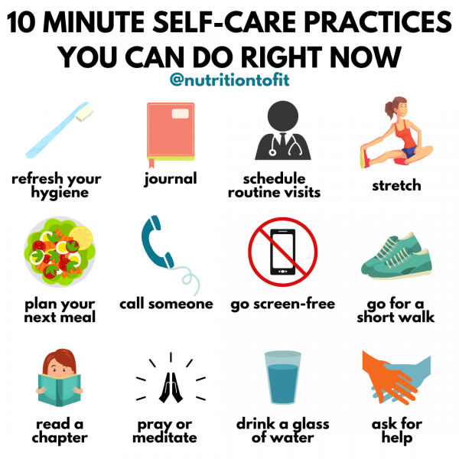
Amy Staples M.A.
amy.staples@marshall.edu

